Slide 1
LIBRARY MANAGEMENT SYSTEM
Presented by:
Shital harishchandra gondhali

Slide 2
INTRODUCTION
Library is the collection of different types of books. It provides books for large number of
readers.Thus we need software for managing the library.
Library management system software provides the systematic handling the records of books and readers.
A library management system is software that is designed to manage all the functions of library.

Slide 3
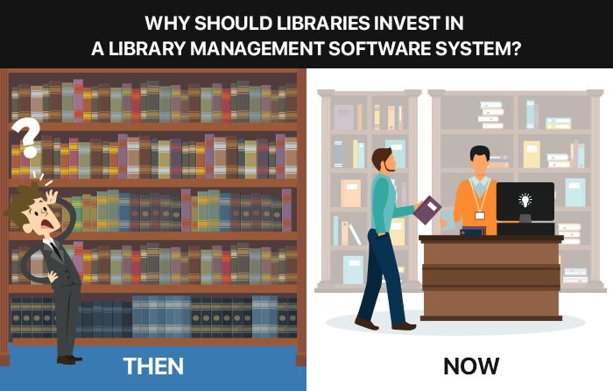

Slide 4
REQUIREMENTS
SOFTWARE REQUIREMENTS:
Eclipse IDE

Slide 5
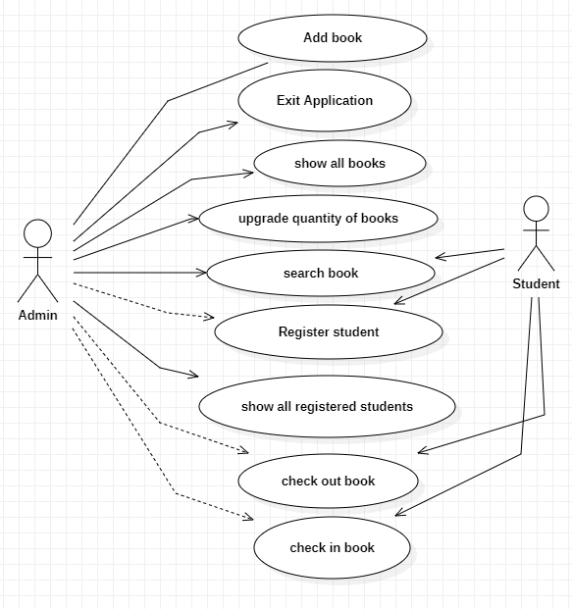
USECASE DIAGRAM

Slide 6
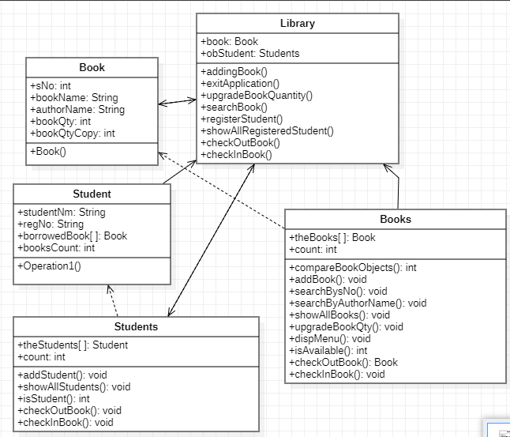
CLASS DIAGRAM

Slide 7
MODULES
Library
Students
Student
Books
Book
Above all are the modules for the Library management System.Through all these modules
We can perform different different operations in the library management System.Adding new books,show all the books,upgrade the quantity of the books like this,there are so many options in the system.When students are going to check in book and check out book,they firstly supposed to get registered first,after that they can easily have the book and can return the book also.

Slide 8
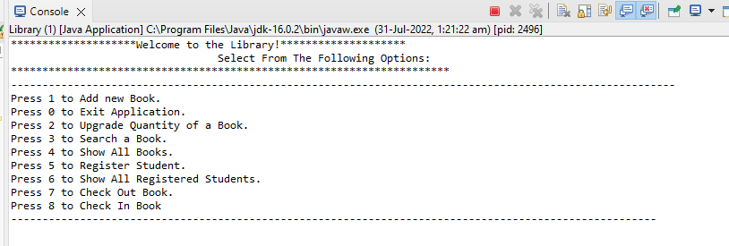
OUTPUTS OF PROJECT
Showing All Menus:

Slide 9
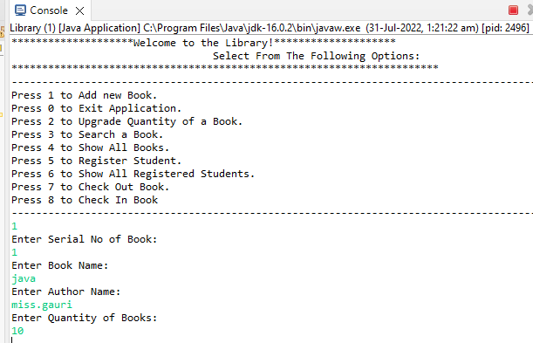
Selecting First Menu: Add new Book

Slide 10
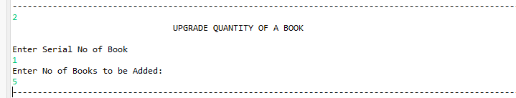
Selecting Second Menu: Upgrade Quantity of book

Slide 11
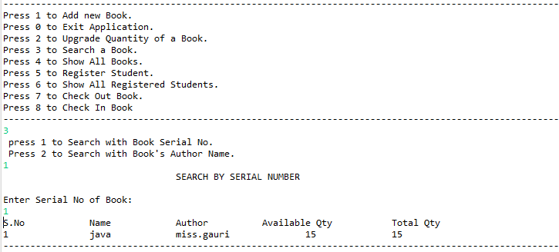
Selecting Third Menu: Search a Book

Slide 12
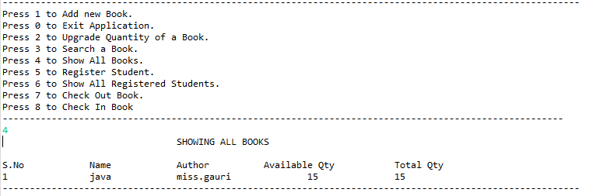
Selecting Fourth Menu: Show All Books

Slide 13
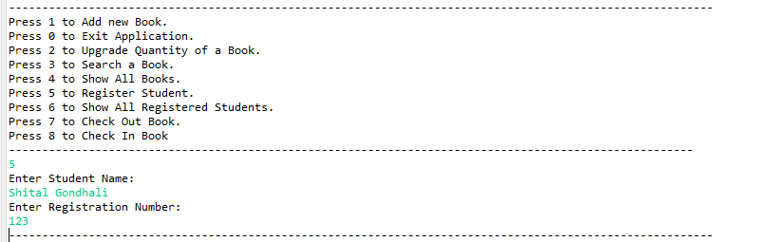
Selecting Fifth Menu: Register Student

Slide 14
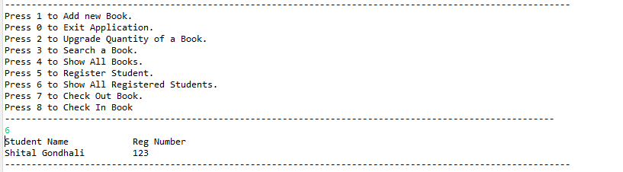
Selecting Sixth Menu: Show All Registered Student

Slide 15
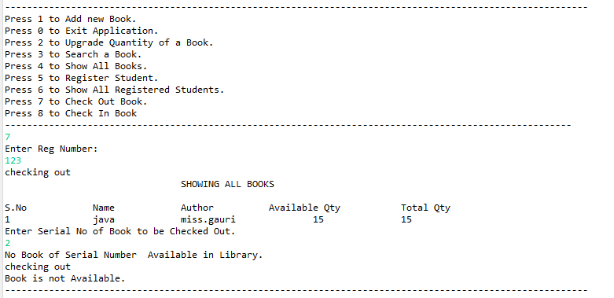
Selecting Seventh Menu: Check Out Book

Slide 16
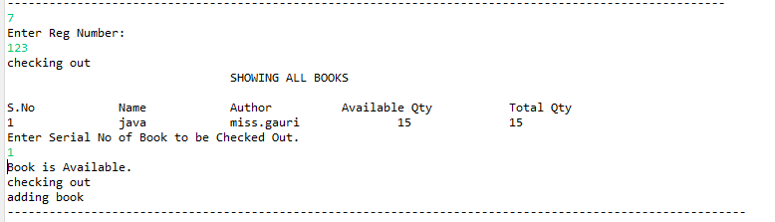

Slide 17
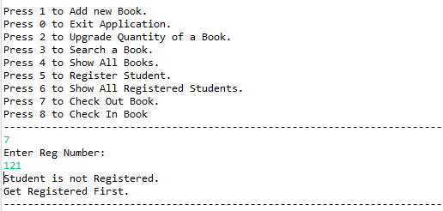

Slide 18
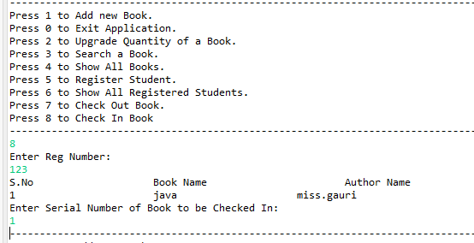
Selecting Eighth Menu: Check In Book

Slide 19
CONCLUSION
We have seen that,We are ready with making the java project which name is Library management System.
Using this software any user without having any knowledge of Java could easily be able to understand the reports of various transactions like availability of books, number of copies, etc.
Here, Java based management system is successfully developed..

Slide 20
REFERENCES…
www.google.com
www.youtube.com

Slide 21


